Slide 1
User Manual
Smart Systems for Occupancy and Building Energy Control
Version 2
Team: Diana Leante Boné, Irvin S. Cardenas Mentor: Ali Mostafavi, Leonardo Bobadilla

Slide 2
Overview
The application Smart System for Occupancy and Building Energy Control allows users to view energy consumption data of zones and to draw conclusions based on statistical analysis of the data.
This manual delivers an overview of the sample application.
General User Features
Login
Create Account
Logout
Add a Zone
Edit a Zone
Select a Zone
Zone Rewards
Zones Description
Temperature
Occupancy
Plug Load
Lighting
Animation Gifs
Prediction of Air Conditioning
Prediction of Consumption of appliances
Add Appliance to a Zone
View Wasteful Regions
Turn Light Off and Earn Points
Turn Appliance Off and Earn Points
Notify Users of Wasteful Regions
View User Rewards
Get Report for Zones
Get Report for User Rankings
View Suggestions
Additional Features
(for Facility Managers only)
Create a Zone
Add a User to a Zone
Remove a User from a Zone
Get Report for All Zones
Get Report for User Rewards
View Suggestions for building

Slide 3
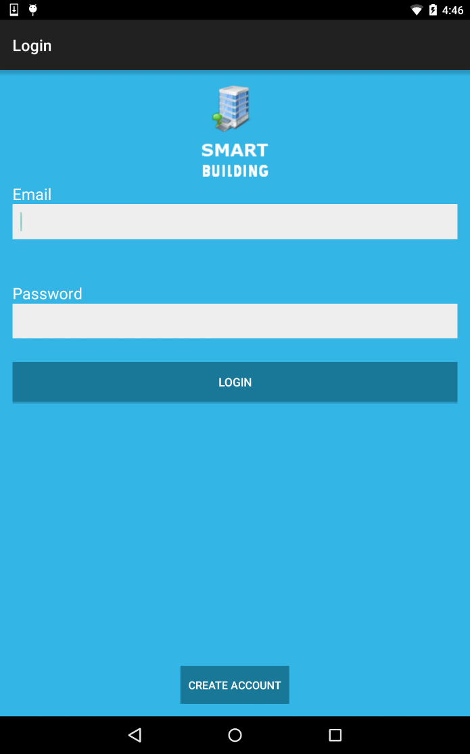
Login
A registered user is required to enter the username and password and click the LOGIN button to login to application.
An unregistered user needs to click the CREATE ACCOUNT button to register, see Create Account.

Slide 4
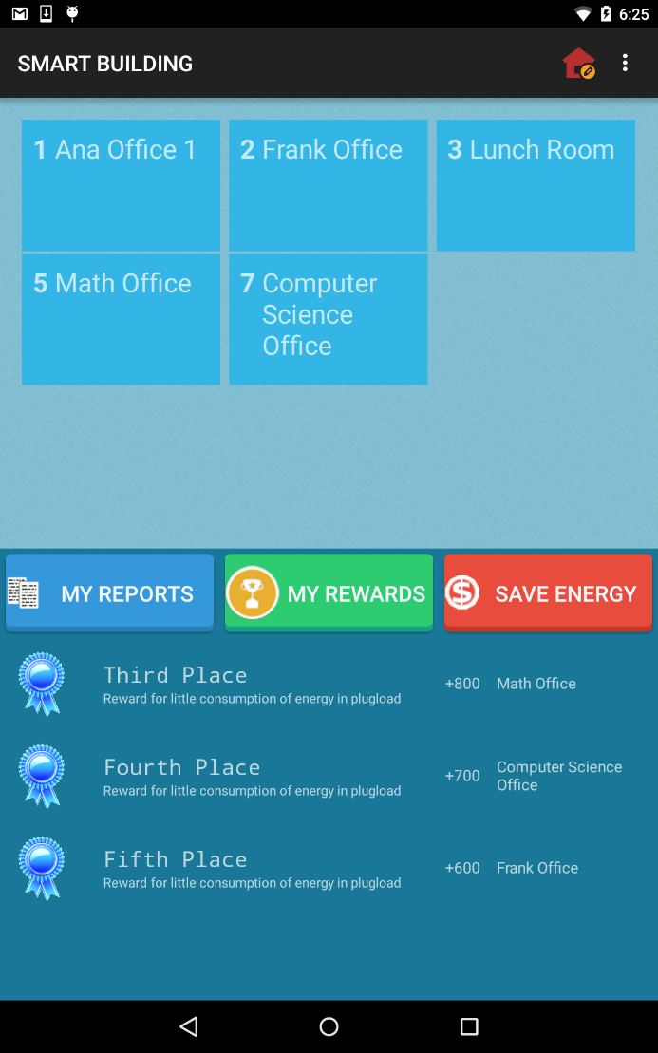
Main Screen
After the user logs in, the Main Screen of the application is displayed with the zones the user has added to his\her account.

Slide 5
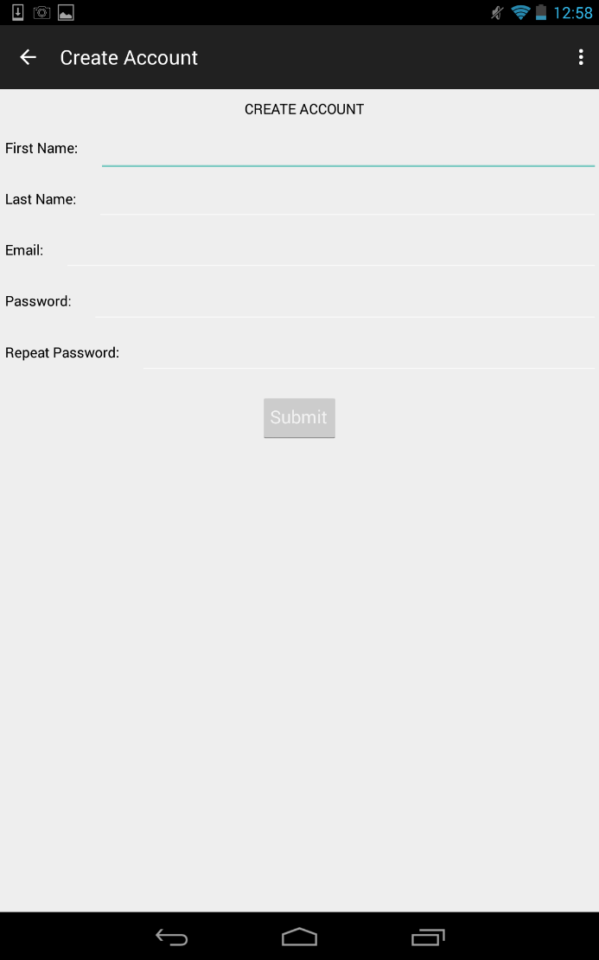
Create Account
The user previously clicked on the CREATE ACCOUNT button on the LOGIN screen.
The user is then required to enter his/her personal information including: First Name, Last Name, Email, Password and Repeat Password and select the Submit button to become a registered user.

Slide 6
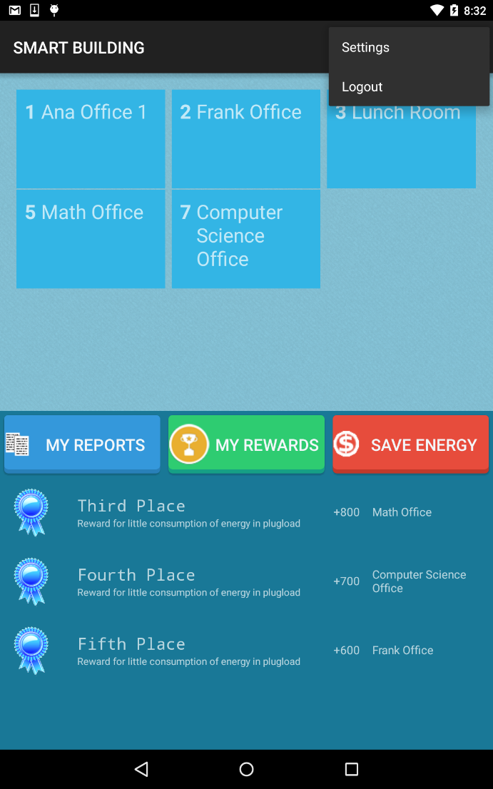
Logout
The user is required to open the popup menu in the Action Bar in order to click in the LOGOUT button

Slide 7
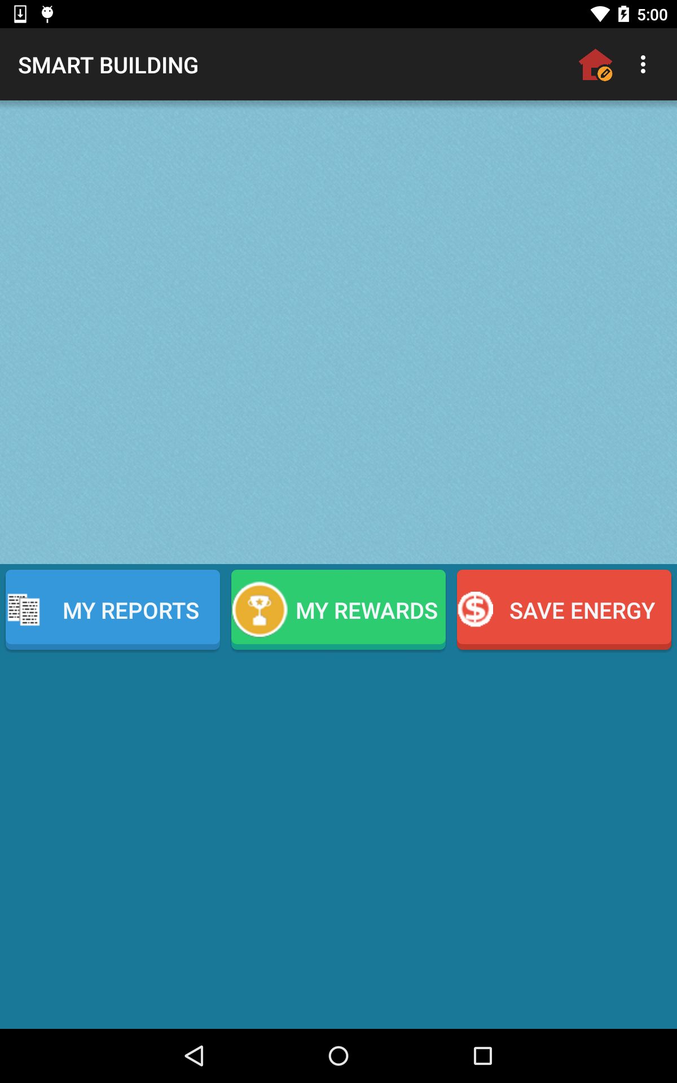
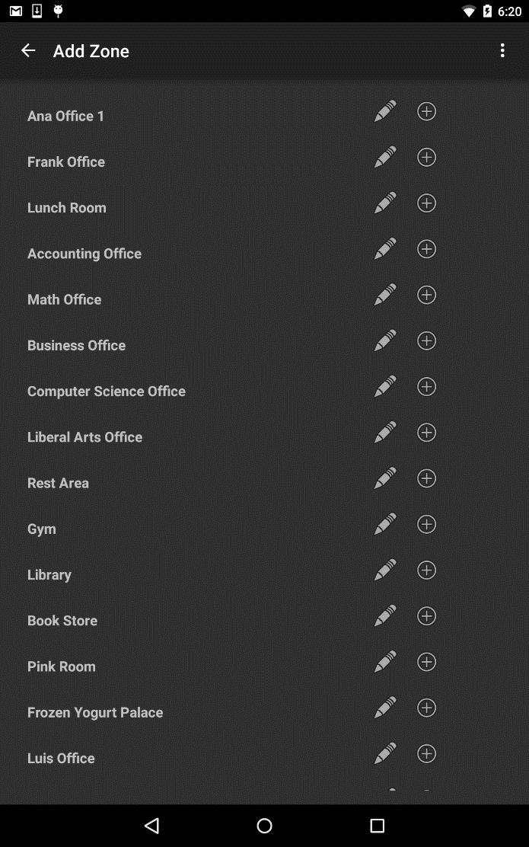
Add a Zone
From the Main Screen, the user can ADD A ZONE by clicking the House Icon in the upper right corner.
The user can then select the ADD button to add the zone to his\her account.

Slide 8
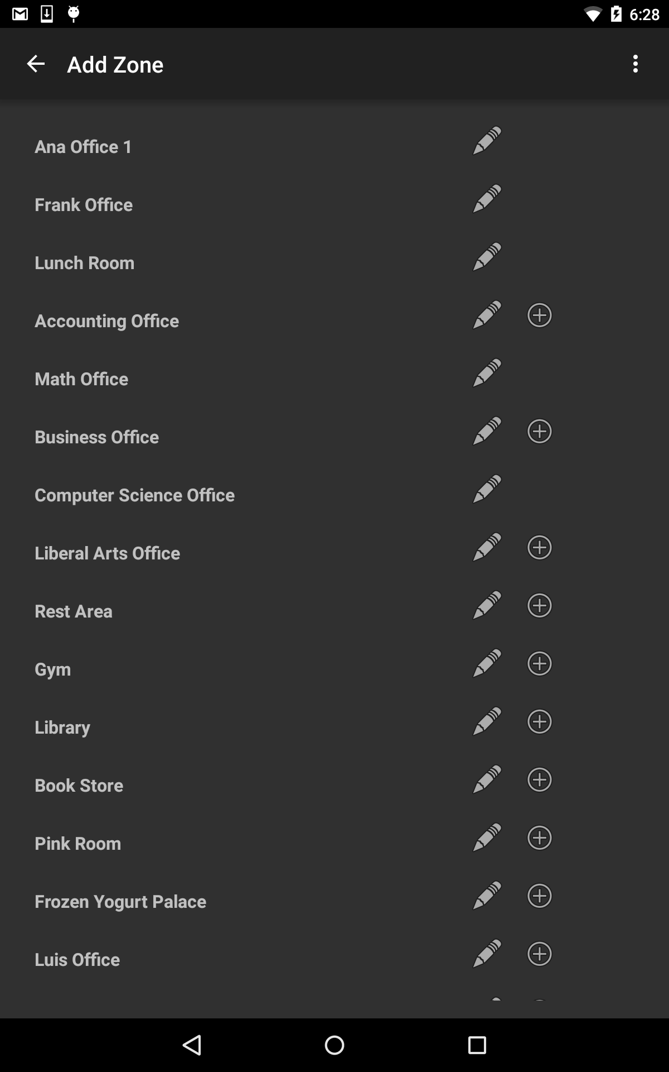
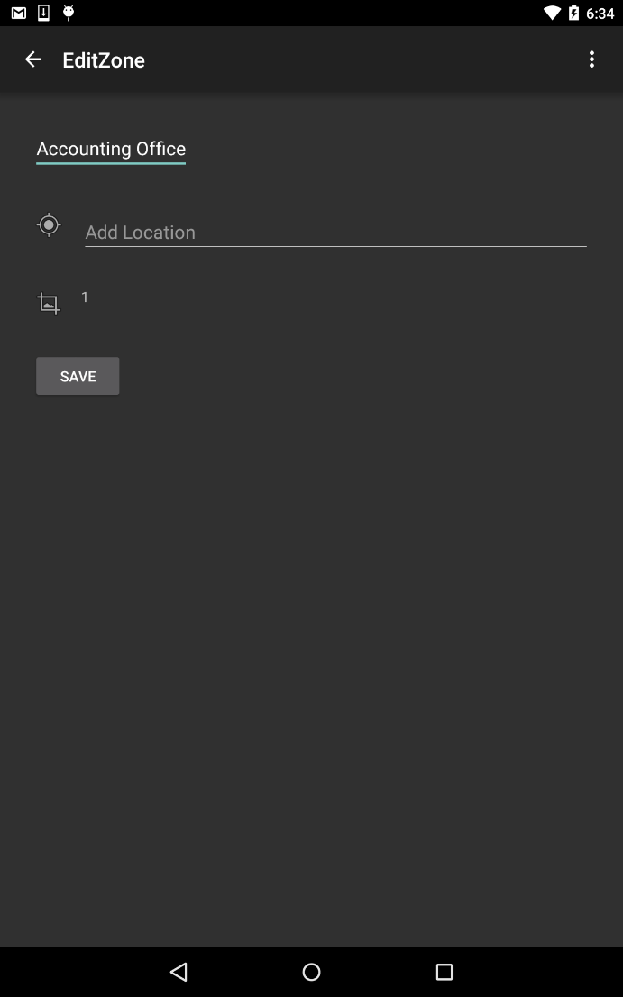
Edit a Zone
The user can EDIT A ZONE by clicking the House Icon in the upper right corner of the Main Screen.
The user can then select the PENCIL button to edit the zone.
The user can edit the zone information and click the SAVE button to keep the changes.

Slide 9
Select a Zone | Zone Rewards
From the Main Screen, the user is required to SELECT A ZONE where he/she can see the different options for energy performance.
The user can see ZONE REWARDS for turning off the lights before leaving the room and also for little consumption of energy in appliances plug load.

Slide 10
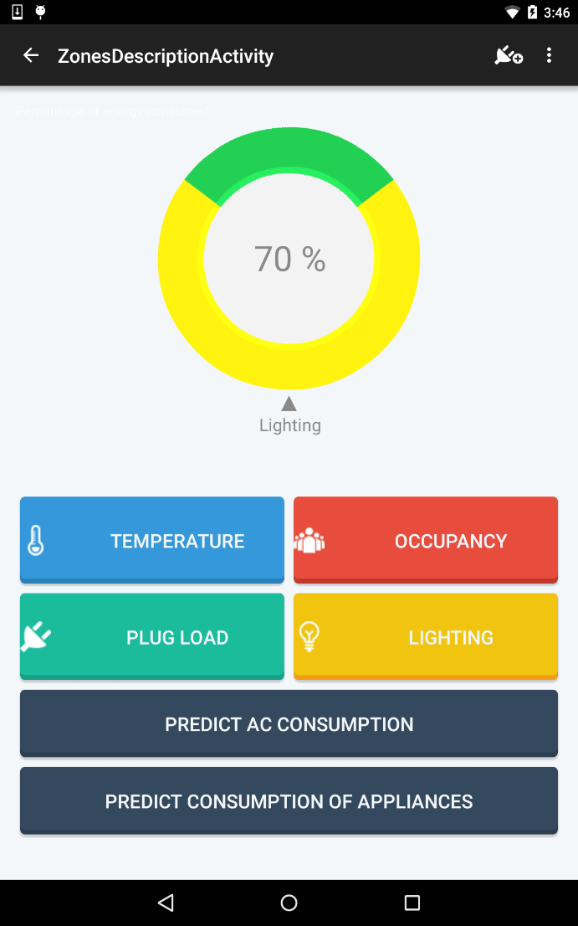
Zone Description
General graphic information of Plug Load and Lighting
The user is required to make a selection in ZONES DESCRIPTION to see Temperature, Occupancy, Plug Load, Lighting, Predict Air Conditioning and/or Predict Consumption of Appliances.

Slide 11
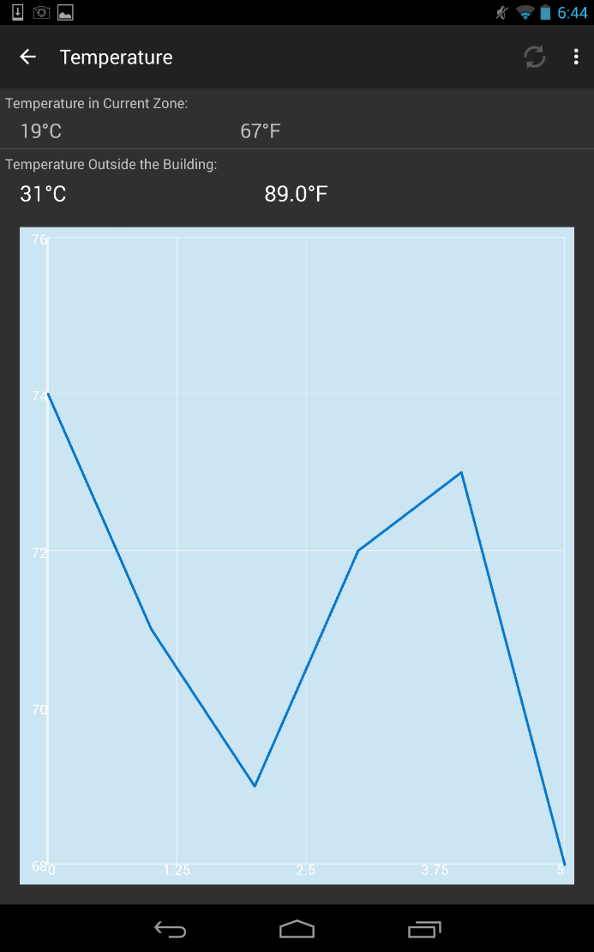
Temperature
After selecting a zone from the Main Screen,
the user can select to view the TEMPERATURE of the zone in a graphic representation and is able to select the REFRESH button on the upper corner in order to update the information.

Slide 12
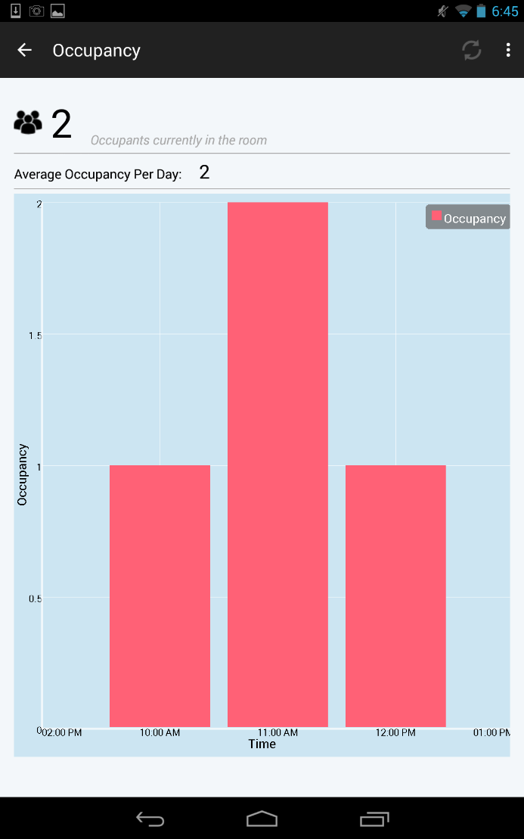
Occupancy
After selecting a zone from the Main Screen,
the user can select to view the OCCUPANCY of the zone in a graph view and is able to select the REFRESH button in order update the information.

Slide 13
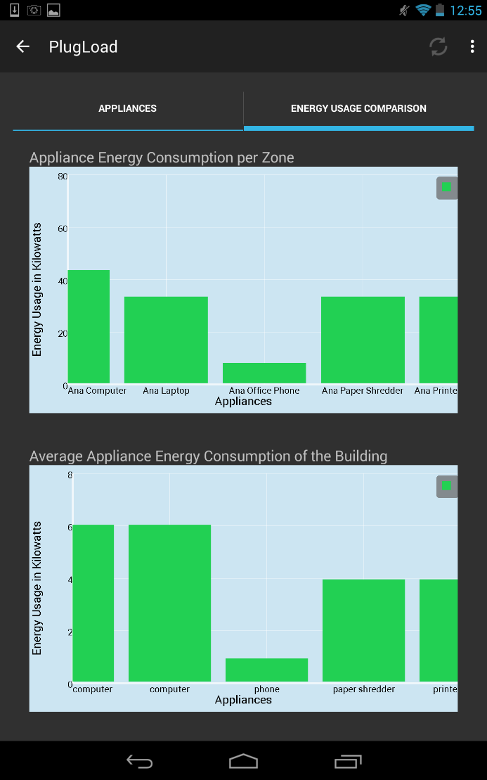
Plug Load
After selecting a zone from the Main Screen,
the user can select to view the PLUG LOAD of the zone and is able to REFRESH in order to get updated information. There is a graphic representation for the appliance energy consumption per zone and the appliances average consumption for the building.

Slide 14
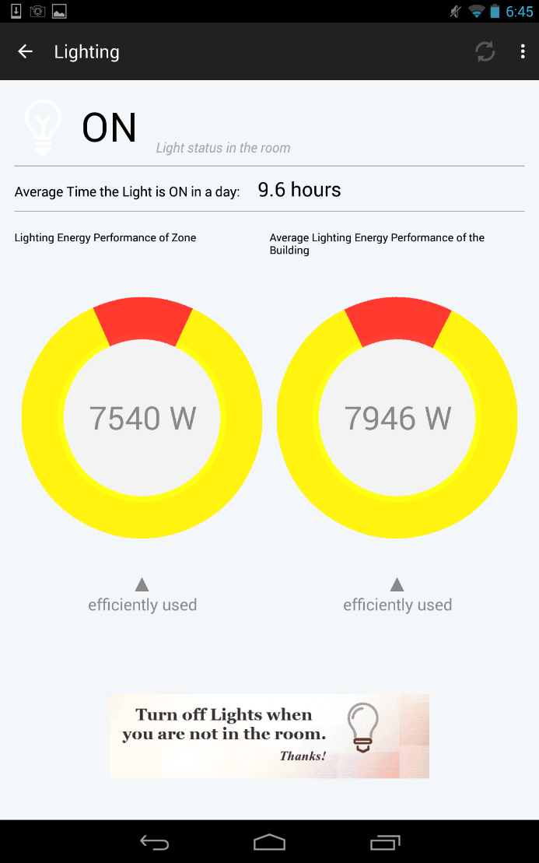
Lighting
After selecting a zone from the Main Screen,
the user can select to view the LIGHTING of the zone and is able to REFRESH in order to get updated information. There is a graphic representation of the lighting energy performance of the zone and the lighting performance of the building.

Slide 15
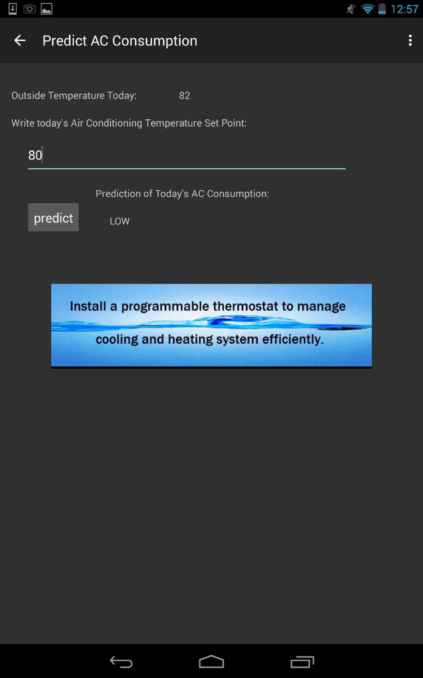
Prediction of Air Conditioning
The user can make a PREDICTION OF AIR CONDITIONING by entering his/her temperature Set Point and clicking the button predict.
The user can see different ANIMATION GIFS in order to learn how to save energy in a simple way.

Slide 16
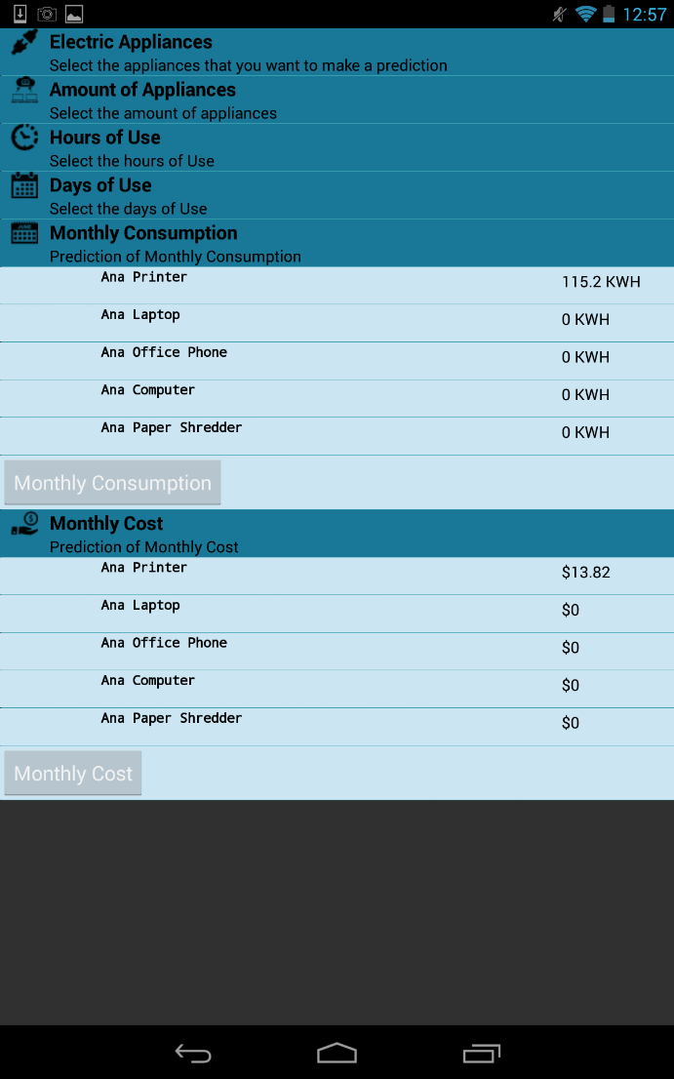
Prediction of Consumption of Appliances
The user can make a PREDICTION OF CONSUMPTION OF APPLIANCES by completing the information in the expandable list and then clicking the Monthly Consumption and Monthly Cost to view these predictions.

Slide 17
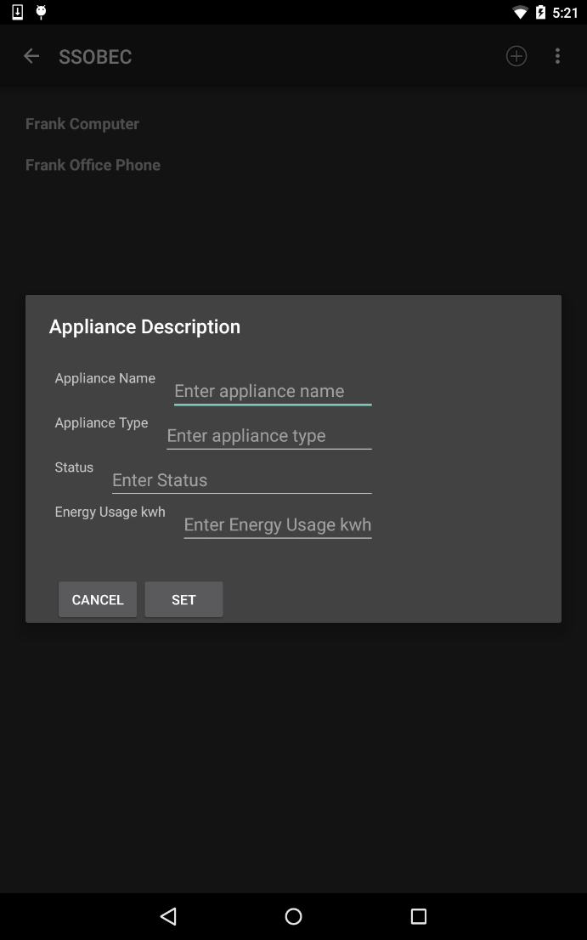
Add Appliance to a Zone
After selecting a zone from the Main Screen,
the user can select the ADD APPLIANCE icon on the upper right corner of the Action Bar.
The user can see all the appliances of the zone and click the ADD button on the upper right corner. The user can enter the information for the appliance and select to SET the data.

Slide 18
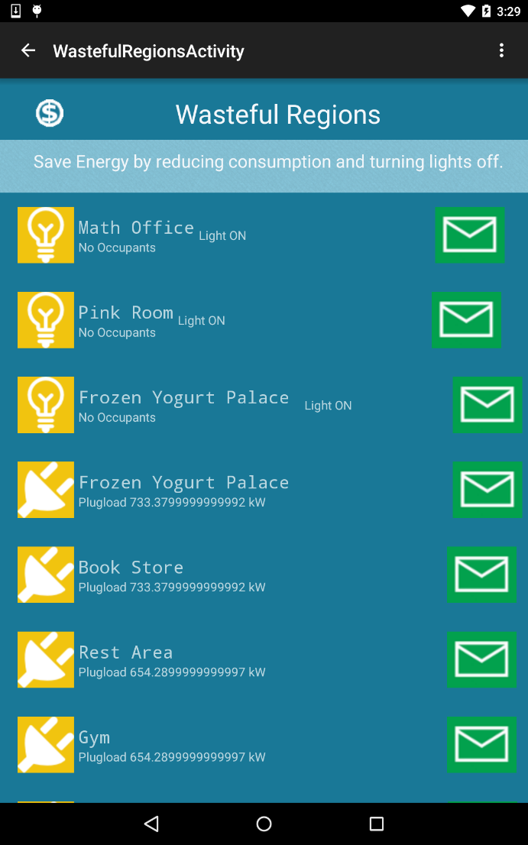
View Wasteful Regions
From the Main Screen, the user can click on SAVE ENERGY to view the wasteful regions.
The user can then select to Turn Off Light in a region with no occupants, Turn Off Appliance, or Notify Users of Wasteful Region.

Slide 19
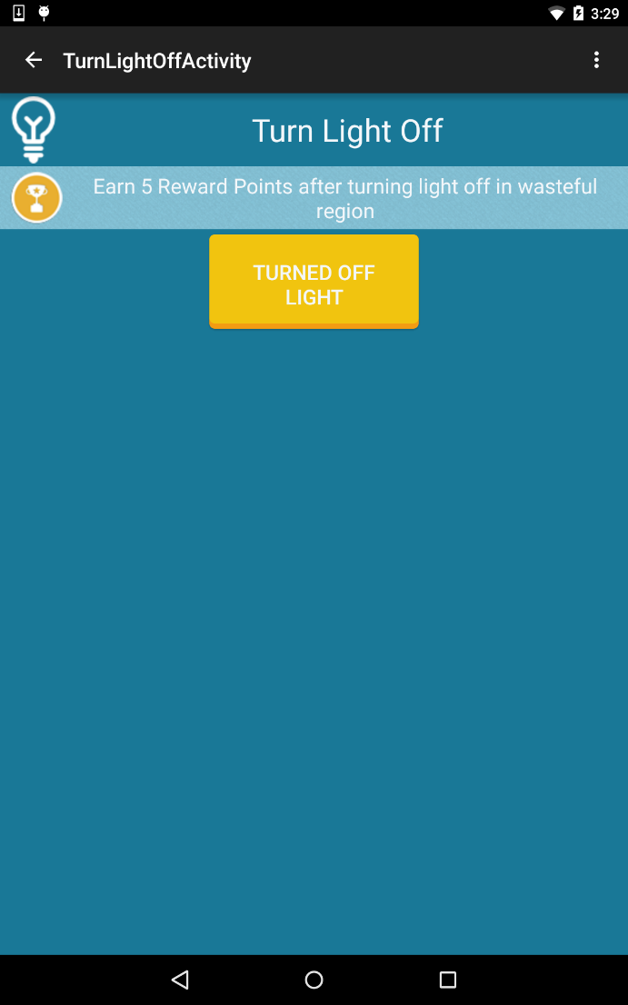
Turn Light Off and Earn Points
After clicking on SAVE ENERGY from the Main Screen, the user can select the Lightbulb icon to Turn Light Off in a region with no occupants.
The user can earn Reward Points by turning off the light and selecting the Turned Off Light button.

Slide 20
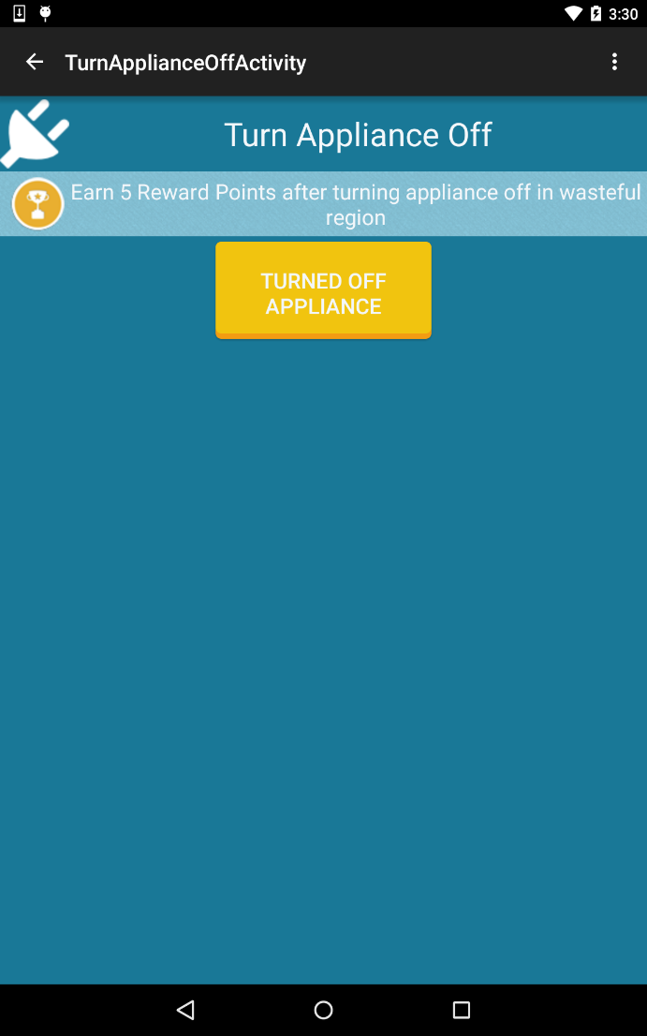
Turn Appliance Off and Earn Points
After clicking on SAVE ENERGY from the Main Screen, the user can select the Plugload icon to Turn Appliance Off in a region.
The user can earn Reward Points by turning off appliance and selecting the Turned Off Appliance button.

Slide 21
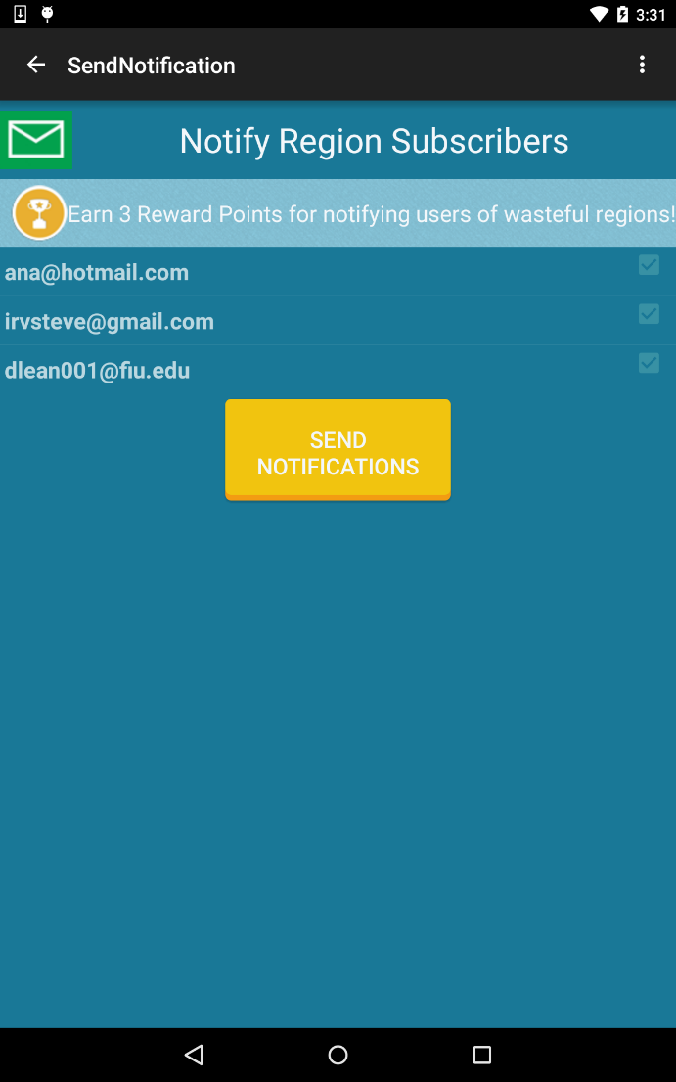
Notify Users of Wasteful Region
After clicking on SAVE ENERGY from the Main Screen, the user can select the Email icon to notify users of the wasteful region.
The user can earn Reward Points by notifying the users through email and selecting the Send Notifications button.

Slide 22
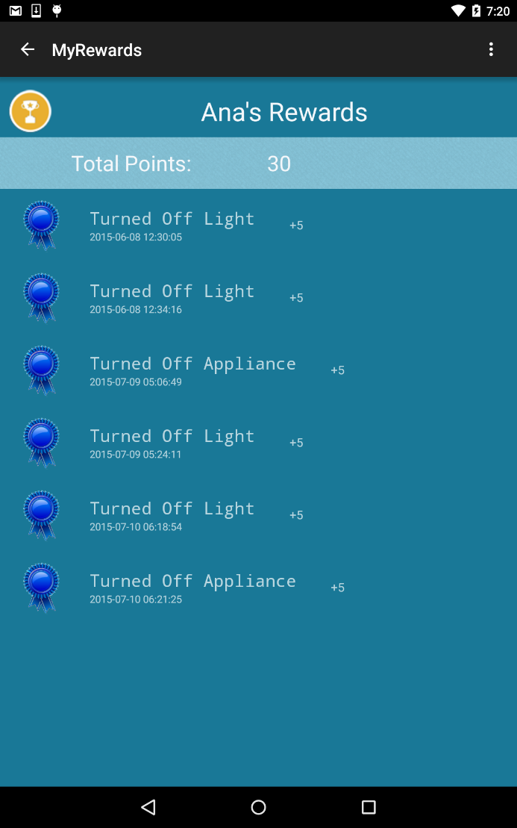
View User Rewards
From the Main Screen, the user can click on MY REWARDS to view his\her Reward Points.
The user can then see the Total Reward Points and the itemized description of his\her reward points earned.

Slide 23
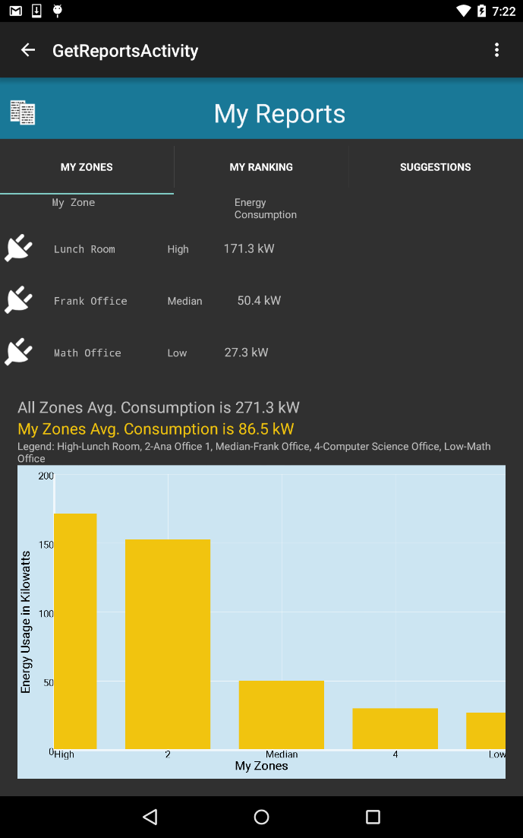
Get Report for Zones
From the Main Screen, the user can click on MY REPORTS to view his\her personalized reports.
The user can then see the statistics for his\her zones and obtain a graph view of his\her zones plugload energy consumption.

Slide 24
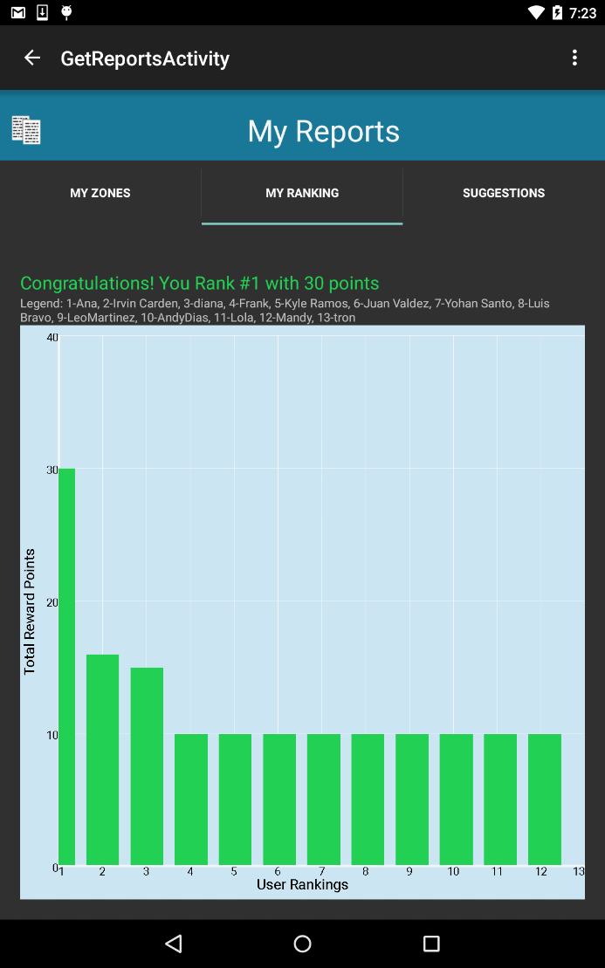
Get Report for User Rankings
From the Main Screen, the user can click on MY REPORTS to view his\her personalized reports.
The user can then see his\her ranking by Reward Points and obtain a graph view of all users Reward Points.

Slide 25
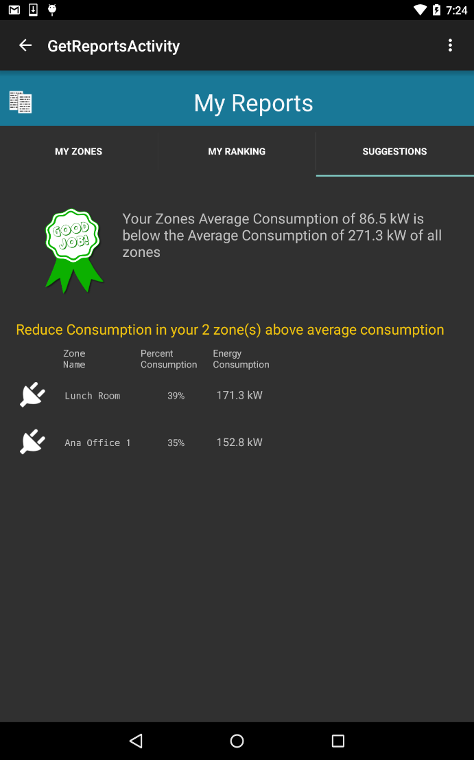
View Suggestions
From the Main Screen, the user can click on MY REPORTS to view his\her personalized reports.
The user can then see the personalized Suggestions and get an itemized list of his\her zones that are above his\her average energy consumption.

Slide 26
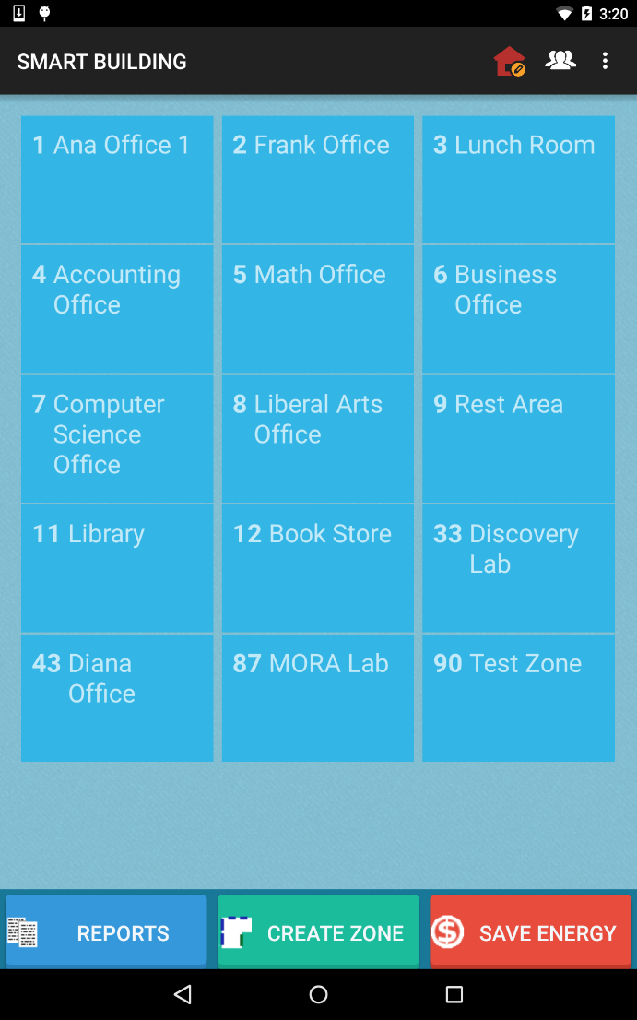
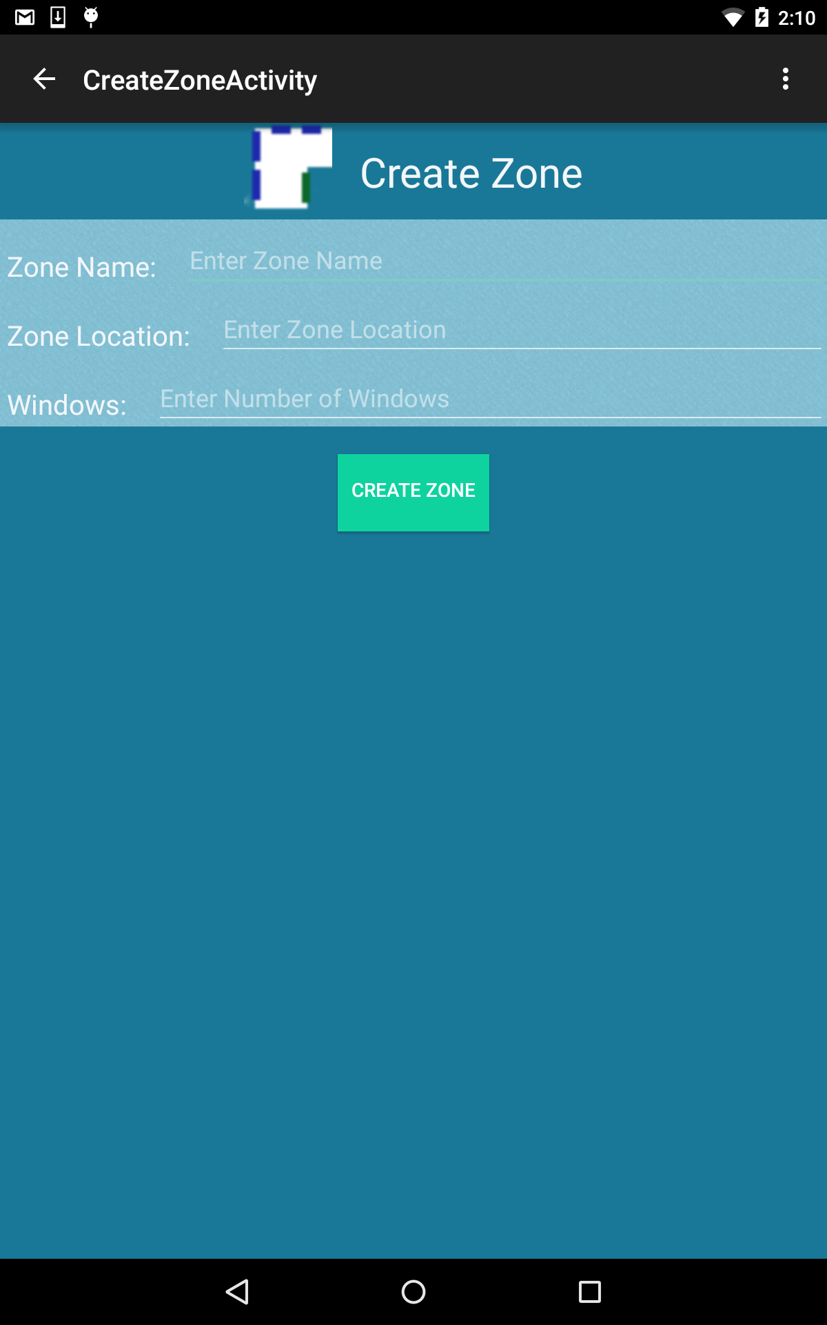
Create a Zone
Additional Features
From the Main Screen for a logged in Facility Manager user, click on CREATE ZONE button.
The facility manager user can then enter the data for a zone such as Name, Location and number of Windows and select the CREATE ZONE button.

Slide 27
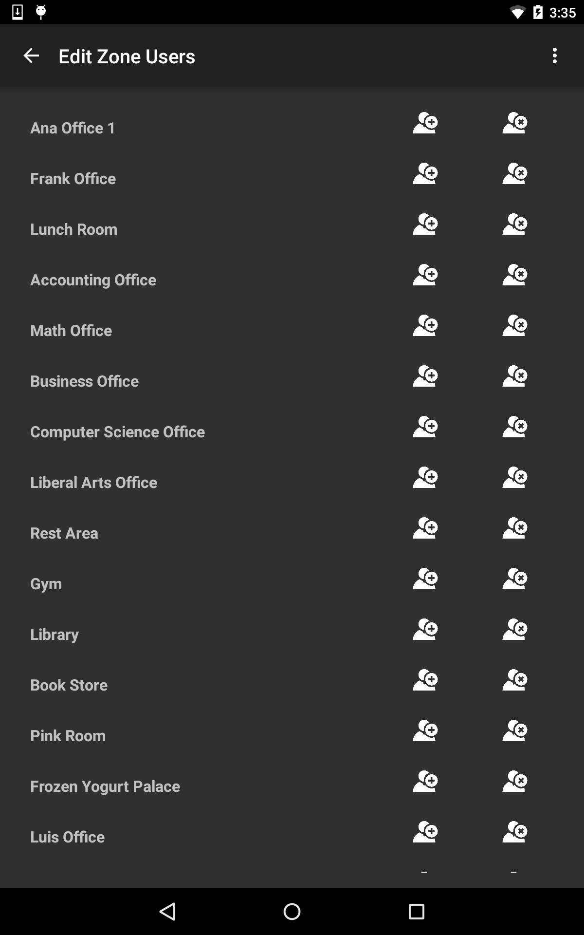
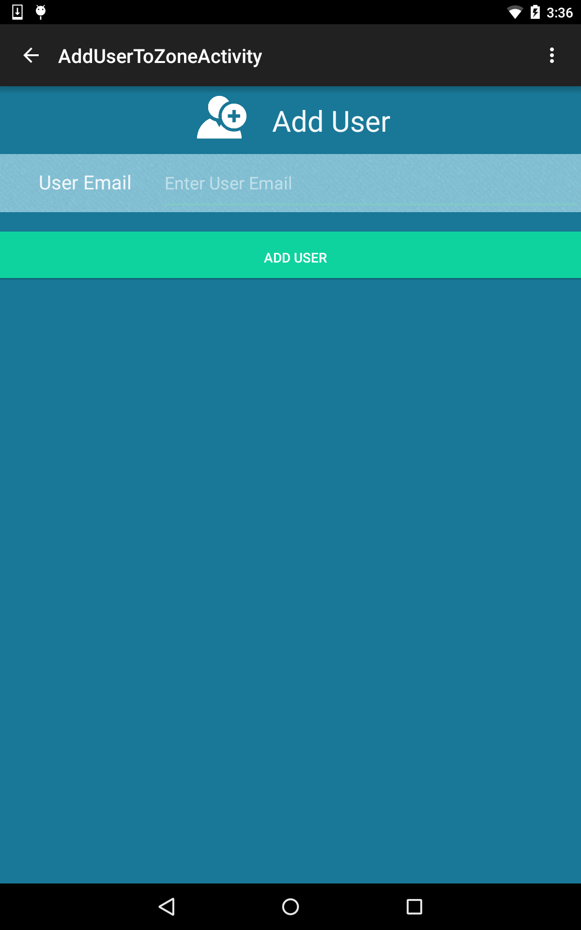
Add a User to a Zone
Additional Features
From the Main Screen for a logged in Facility Manager user, click on the users icon in the upper right corner of the Action Bar.
The facility manager user can then select the Add User icon for a specific zone.
The facility manager can then enter the user’s email and select the Add User button.

Slide 28
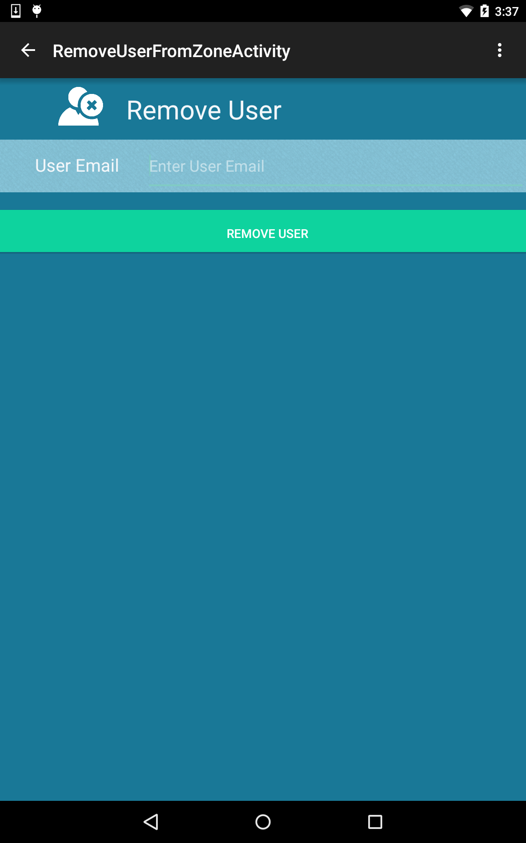
Remove a User from a Zone
Additional Features
From the Main Screen for a logged in Facility Manager user, click on the users icon in the upper right corner of the Action Bar.
The facility manager user can then select the Remove User icon for a specific zone.
The facility manager can then enter the user’s email and select Remove User button.

Slide 29
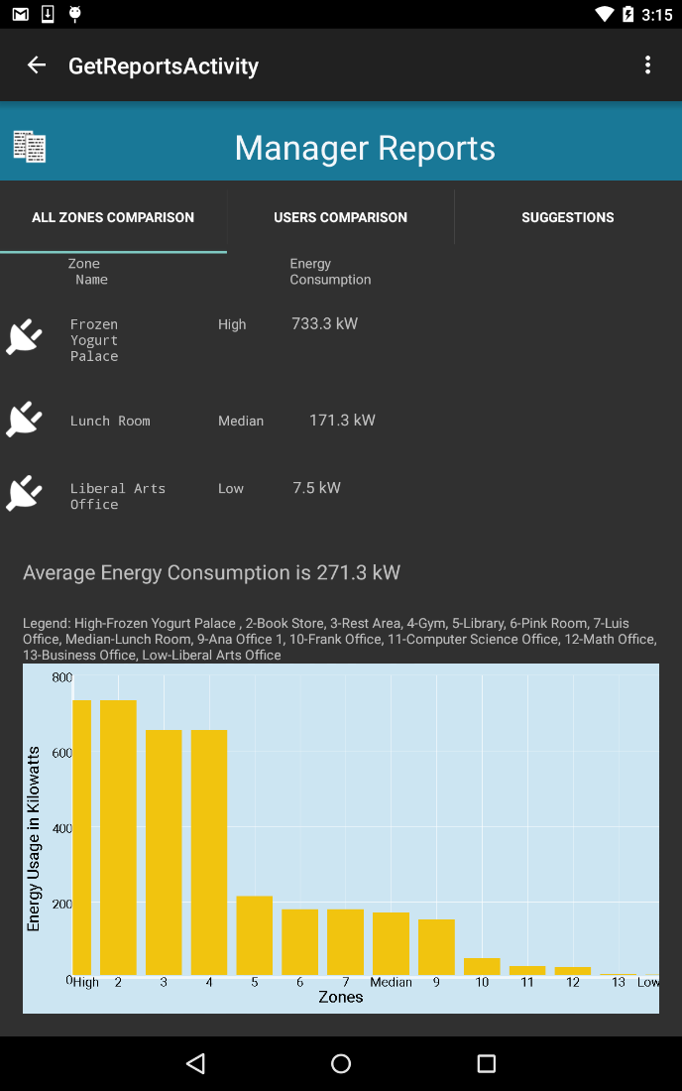
Get Report for All Zones
Additional Features
From the Main Screen for a logged in Facility Manager user, click on REPORTS button.
The Facility Manager user can then see the statistics for all zones in building and obtain a graph view of all zones plugload energy consumption.

Slide 30
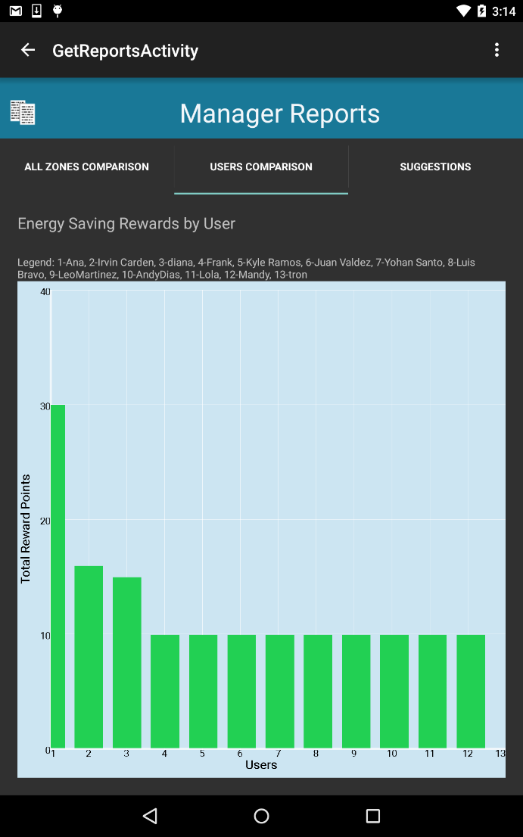
Get Report for User Rewards
Additional Features
From the Main Screen for a logged in Facility Manager user, click on REPORTS button.
The Facility Manager user can then see the Users Comparison by Reward Points and obtain a graph view of all users Reward Points.

Slide 31
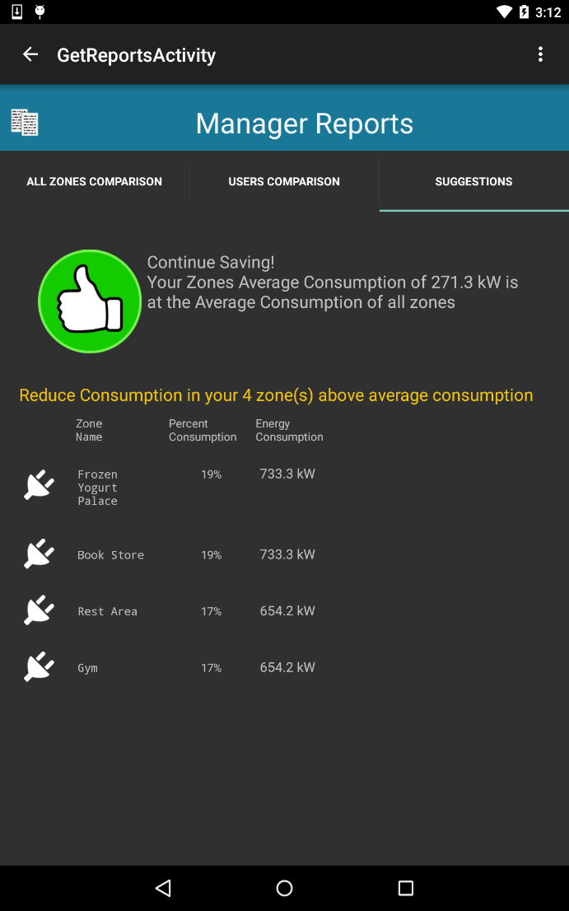
View Suggestions for building
Additional Features
From the Main Screen for a logged in Facility Manager user, click on REPORTS button.
The Facility Manager user can see the Suggestions and get an itemized list of all zones that are above the average energy consumption of the building and their percent consumption.

